Slide 1
Comparative Study of Data-Driven and Compressed Sensing Methods in FWI
Zhongyu Lin, Zhijun Zhang, Zhehao Zhang

Slide 2
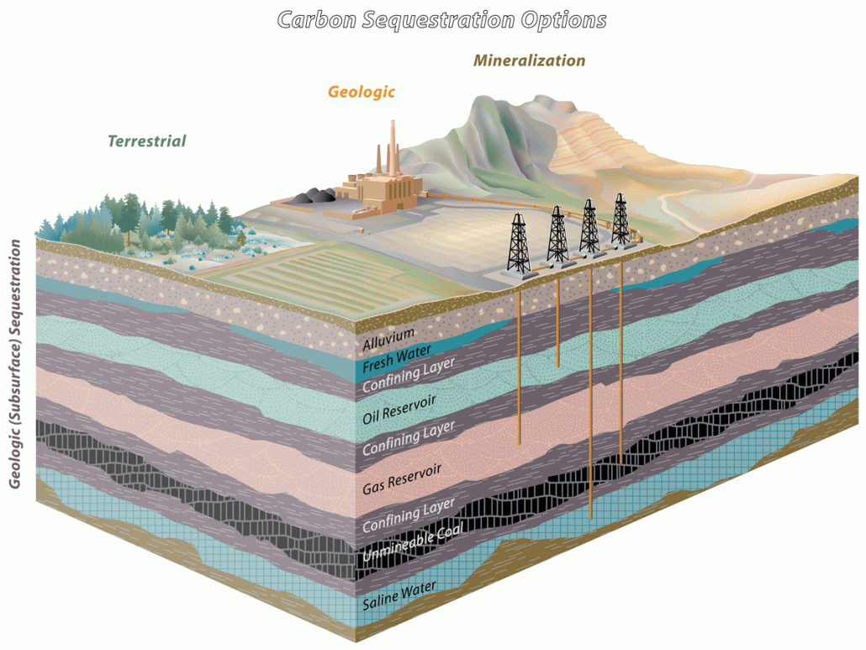
Background
Necessary of FWI:
Understand Subsurface Structures: FWI reconstructs high-resolution velocity maps from seismic data to understand the subsurface.
Supporting key applications:
Carbon sequestration
Reservoir identification
Subsurface energy exploration
Earthquake early warning

Slide 3
Background
Current Limitations(FWI)
Physics-driven FWI:
High Computational Cost: complex Partial Differential Equations (PDEs).
Non-Convex Optimization Problem: e.g., cycle-skipping.
Ill-Posedness: make results unstable or ambiguous.
Data-driven FWI:
Insufficient Capability for Complex Structures: e.g., curved faults
Poor Generalization Ability: Models perform poorly when directly applied to datasets with different geological features, and hard to compare different methods.
Lack of Efficiency: Advanced methods (UPFWI, InversionNet3D) face high computational costs.
Less Mature on 3D FWI: Fewer benchmarks are available for 3D FWI compared to 2D.

Slide 4
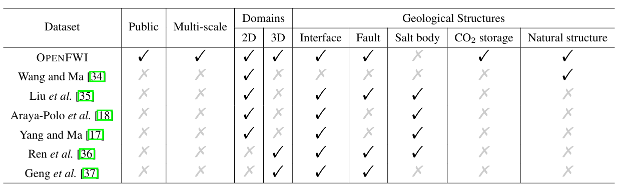
Background
Current Limitation(Dataset):
Lack of Public Datasets.
Current datasets don't cover all the necessary feature data.

Slide 5
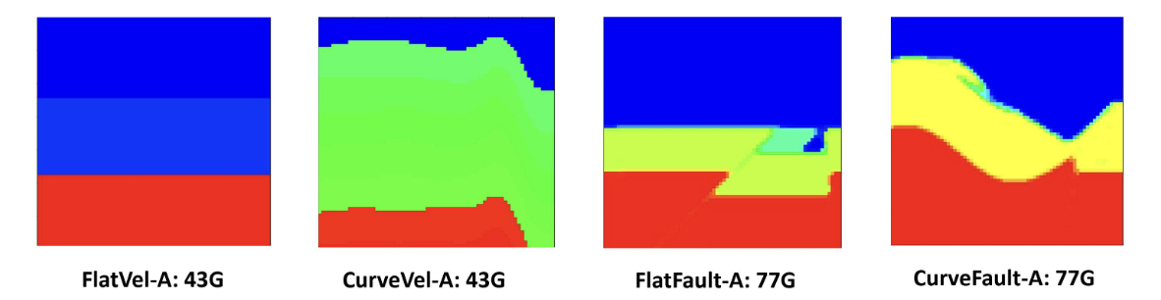
Why OPENFWI
Method:
Enable Fair Comparisons: Fair comparisons between different FWI methods
Support Benchmarking: Perform benchmarking over various methods.
1. Multilayer perceptron.
2. Recurrent networks, CNNs, GANs
3. Extend from 2D to 3D.
Establish Baselines: Provide baseline results to measure future developments

Slide 6
Why OPENFWI
Dataset :
Fill the Need for Public Data.
Provide Large-Scale Datasets with Multiple Subsurface Structures.
Meet Growing Demand
-Driven by the success of data-driven FWI methods in the geophysics community
Ensure Diversity.
1. Geophysical domains: Interface, Fault, CO2​ storage.
2. Geological structures: Flat, Curve.
3. Sample sizes, 3D dataset.

Slide 7
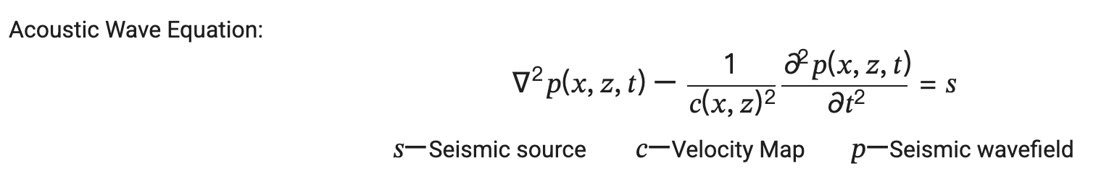
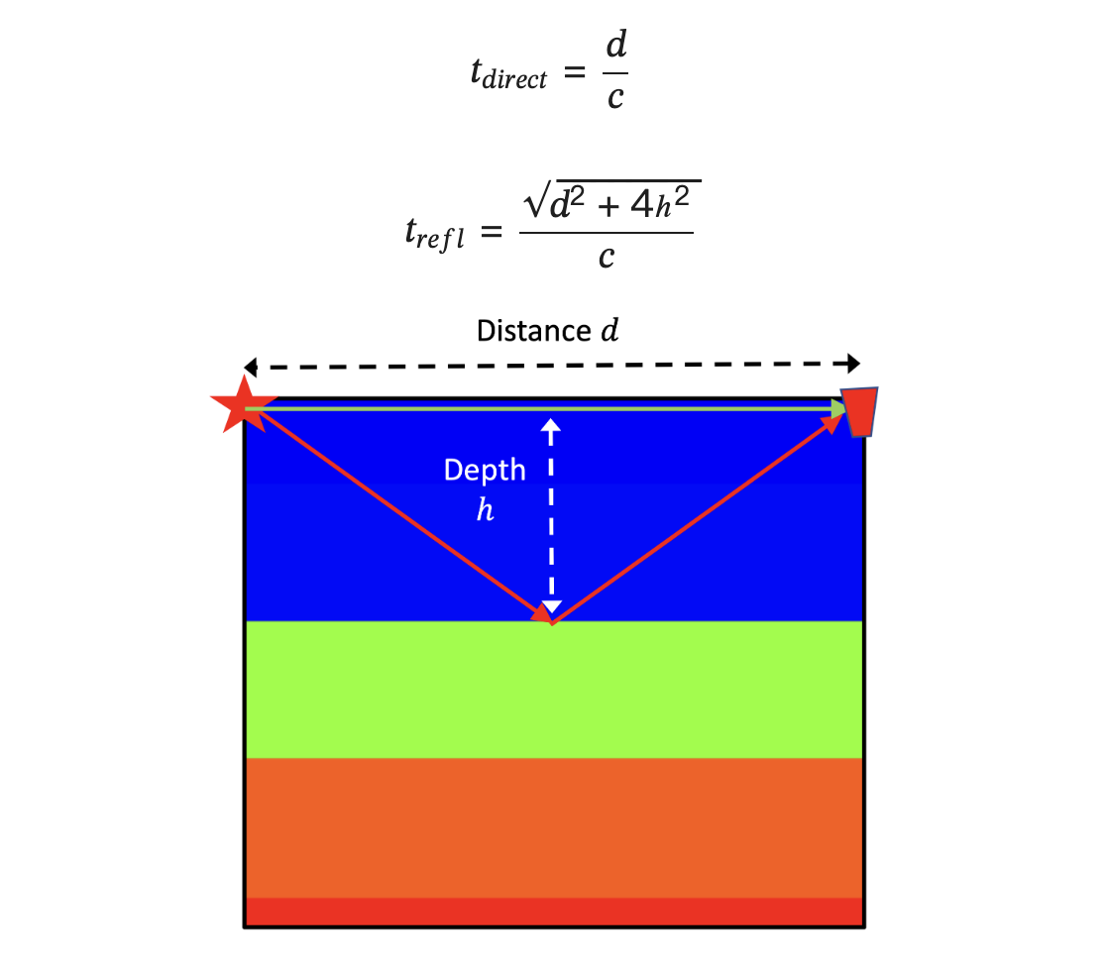
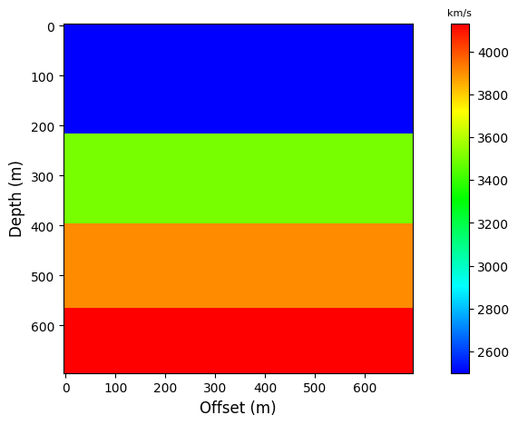
Dataset :
Seismic Data Simulation via Forward Modeling
p: pressure wavefield (seismic signal)
c: subsurface velocity model
s: seismic source (typically a Ricker wavelet)

Slide 8
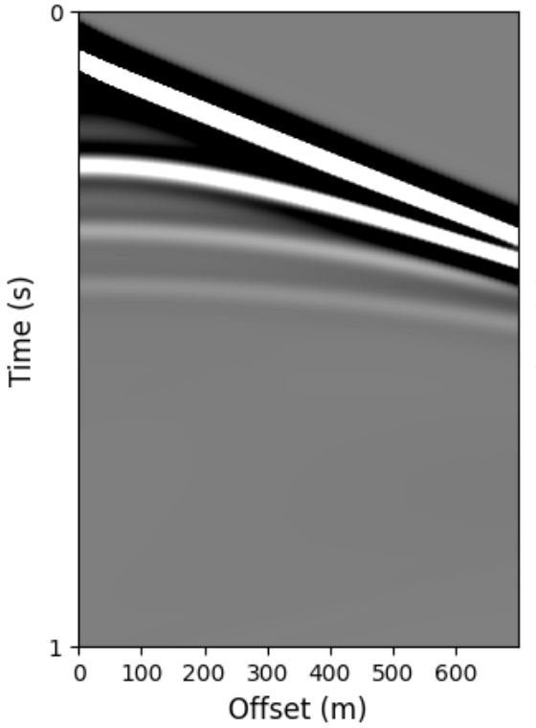
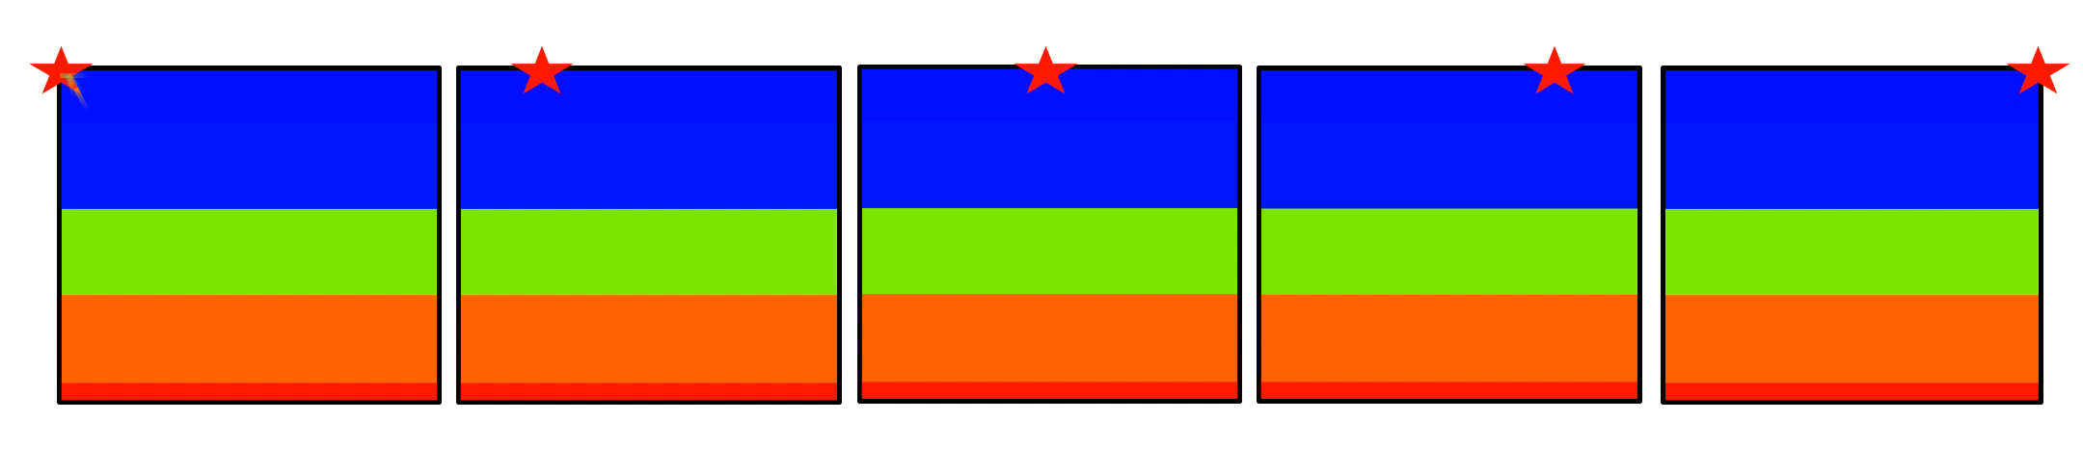
Dataset :
Source and Receiver Configuration
Sources: Seismic sources are injected near the surface at multiple locations (e.g., 5 per sample in Vel Family).
Receivers: A linear array of receivers (e.g., 70) records wavefield responses over time (e.g., 1000 time steps).
This configuration mimics how field seismic surveys are conducted.
velocity data shape(120, 1, 70, 70),
seismic data shape(120, 5, 1000, 70)

Slide 9
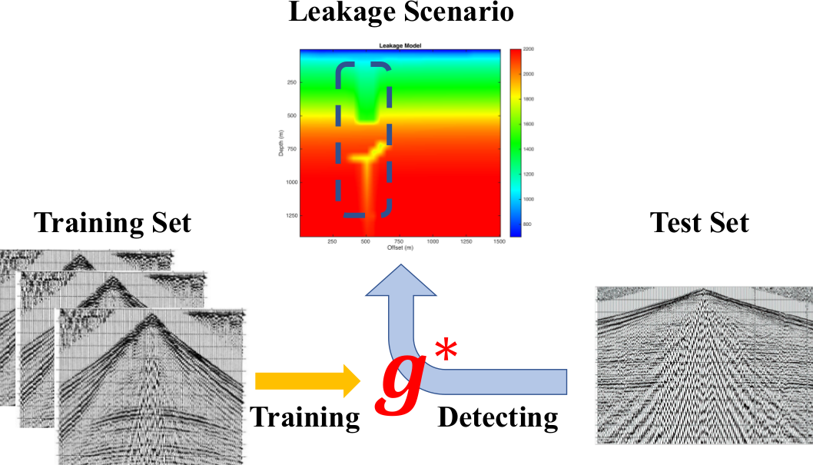
DL Methods
InversionNet:
Core Idea: Full-waveform inversion is traditionally computationally intensive and prone to low-resolution results due to ill-posedness and cycle skipping. To overcome these challenges, an encoder-decoder CNN with a CRF module to directly map seismic data to velocity structures, bypassing the need for the forward operator.
Advantages: Simple, fast convergence, stable training, and high accuracy on simple datasets.
Limitations: No physical constraints; prone to overfitting on complex structures or sparse data.

Slide 10
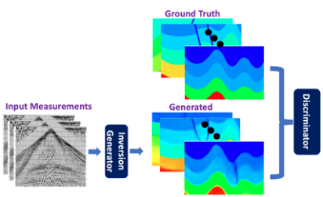
DL Methods
VelocityGAN:
Core Idea: A data-driven inversion method that treats seismic inversion as an image-to-image translation task. By using a GAN, it learns task-specific regularization, with the discriminator penalizing unrealistic velocity maps based on training data distributions.
Advantages: Produces richer and more realistic geological details. Better robustness against overfitting compared to InversionNet.
Limitations: Training is unstable and more prone to mode collapse. Requires significantly longer training times.

Slide 11
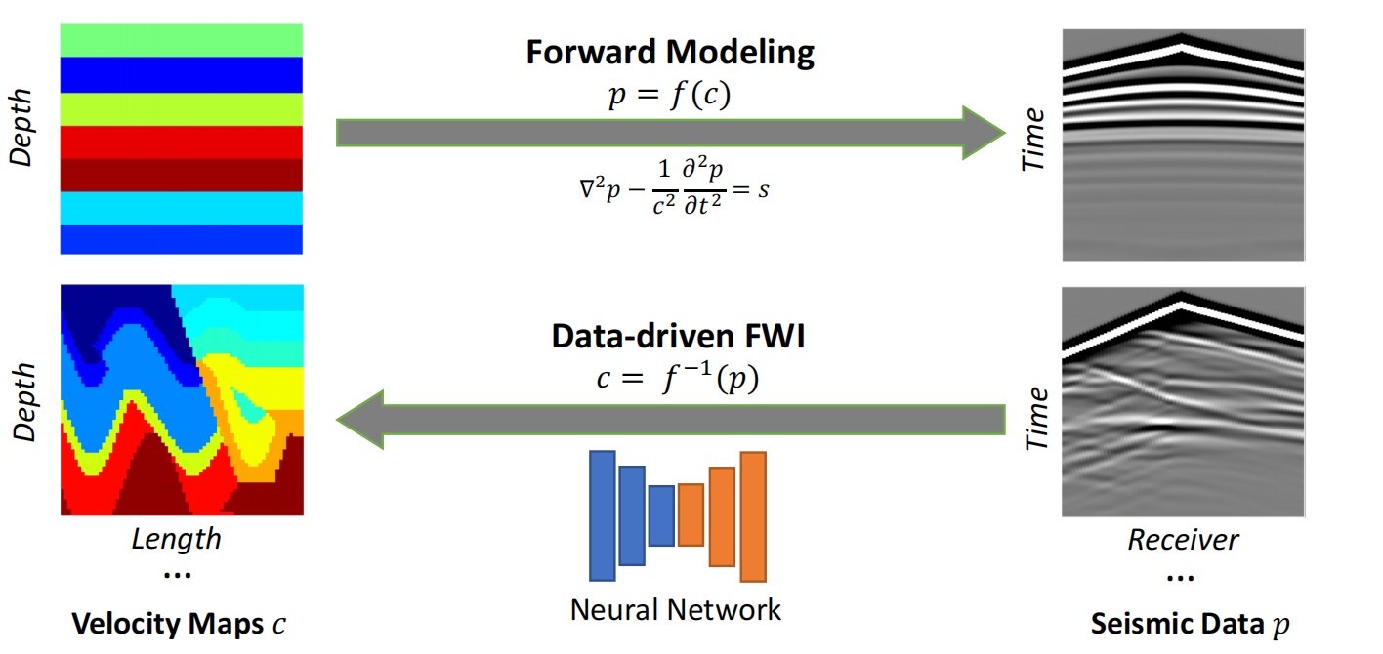
DL Methods
UPFWI:
Core Idea: An unsupervised method combining PDE-based forward modeling and CNN-based inversion, requiring only seismic data. Team also introduced the OpenFWI dataset, with experiments showing UPFWI achieves accuracy comparable to supervised methods and even surpasses them with more data.
Advantages: No need for labeled velocity maps. Potentially applicable to real field data with no annotations.
Limitations: Forward modeling introduces cumulative errors. Achieves lower accuracy compared to supervised methods.

Slide 12
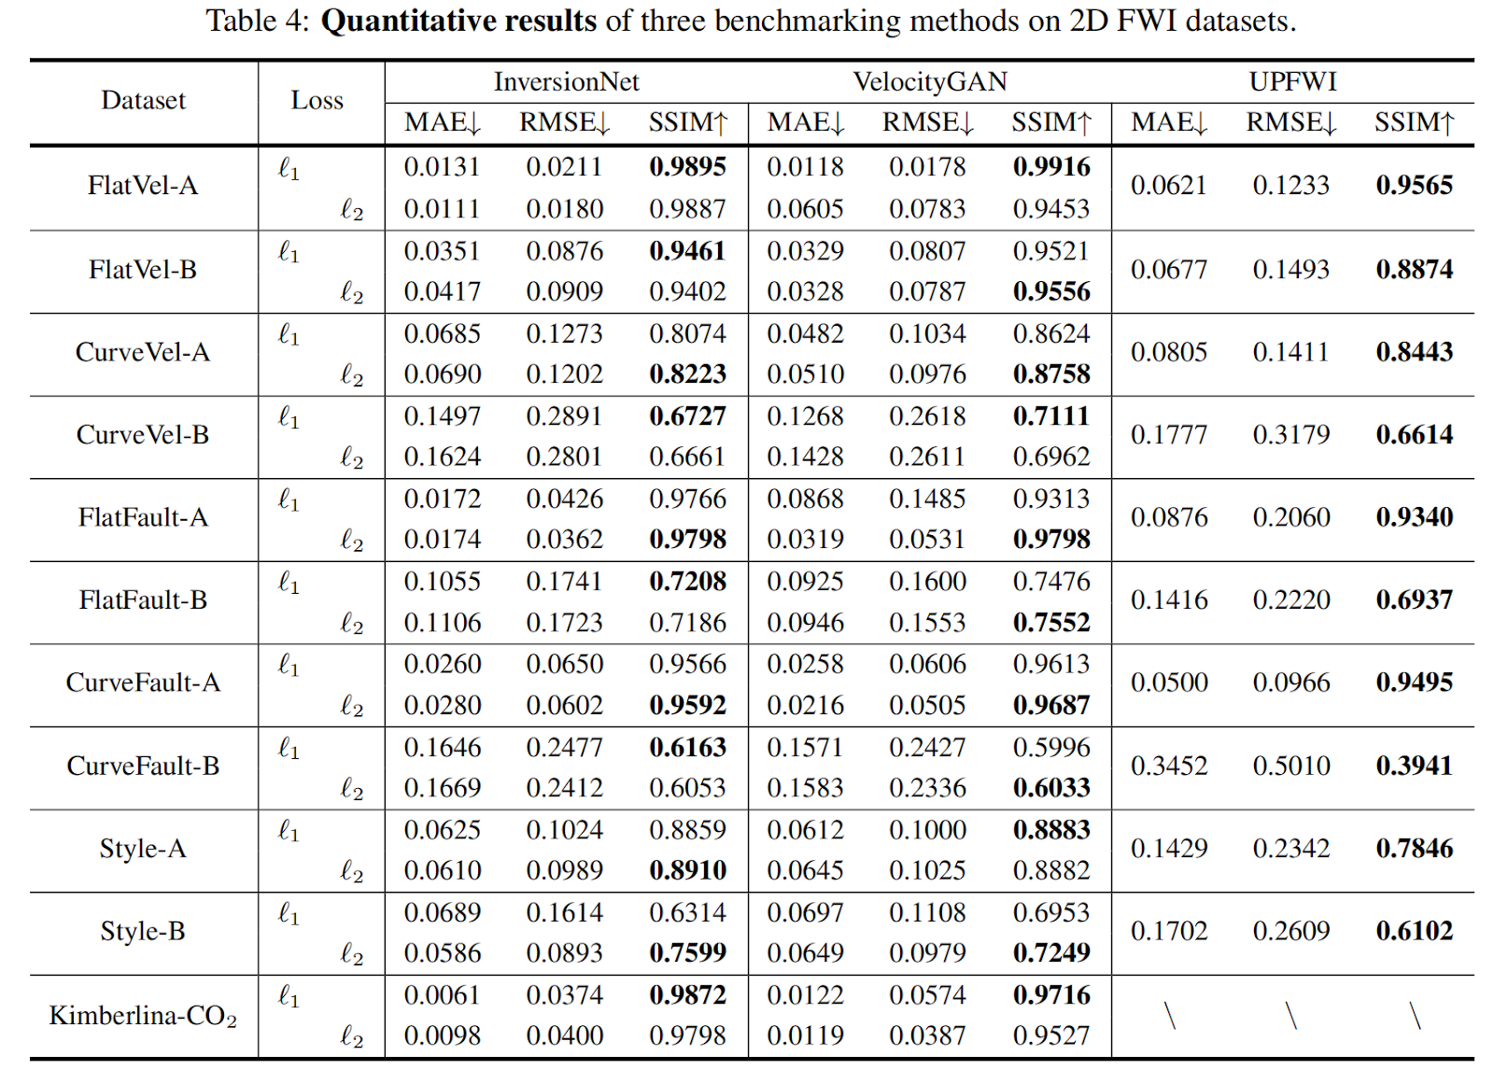
Evaluation Method
SSIM:
Measures how similar two images are based on luminance, contrast, and structural information.
Value ranges between 0 and 1; closer to 1 indicates better similarity.
SSIM captures perceived visual similarity more effectively than pure pixel-wise metrics.

Slide 13
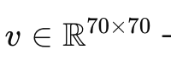
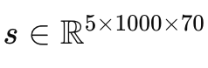
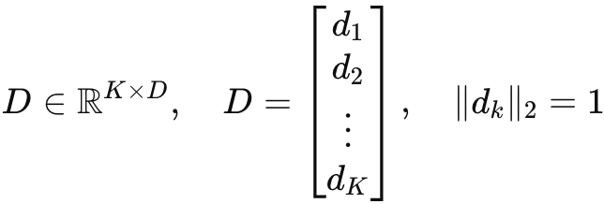
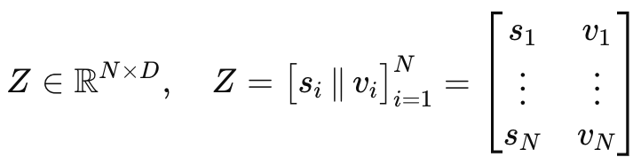
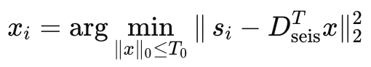
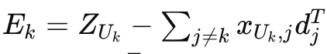
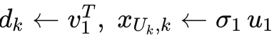
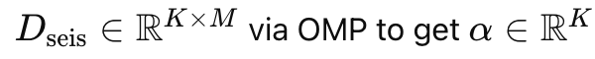
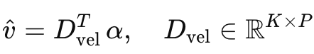
Compressed Sensing
K-SVD
1. Problem Setup
Forward: Velocity map
seismic gather
via wave physics
Inverse goal: Recover v from new s without a full PDE solve
2. Joint Dictionary Learning (K-SVD)
Data matrices
Dictionary
Sparse codes
3. Alternating Algorithm
set
E-step (OMP)
M-step (SVD)
4. Test-time Inversion
Sparse-code y with the learned seismic dictionary
Reconstruct velocity

Slide 14
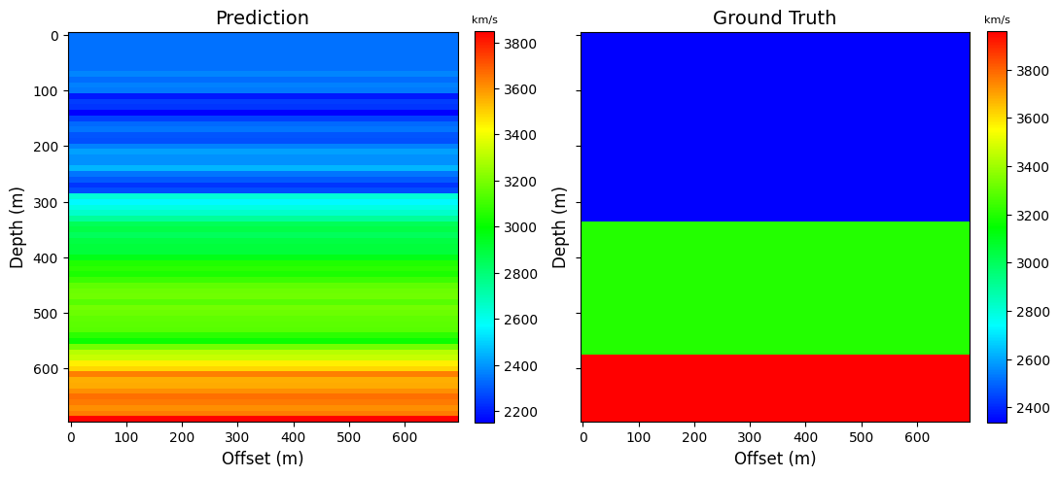
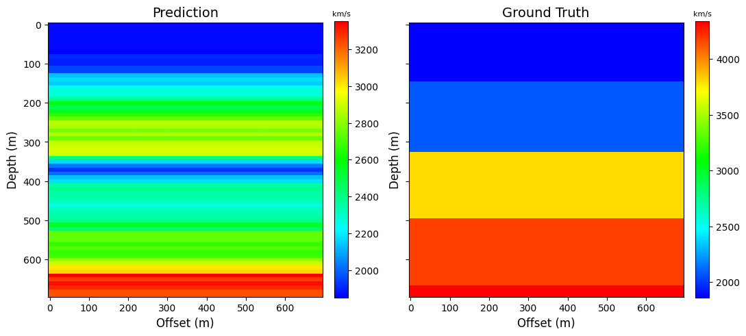
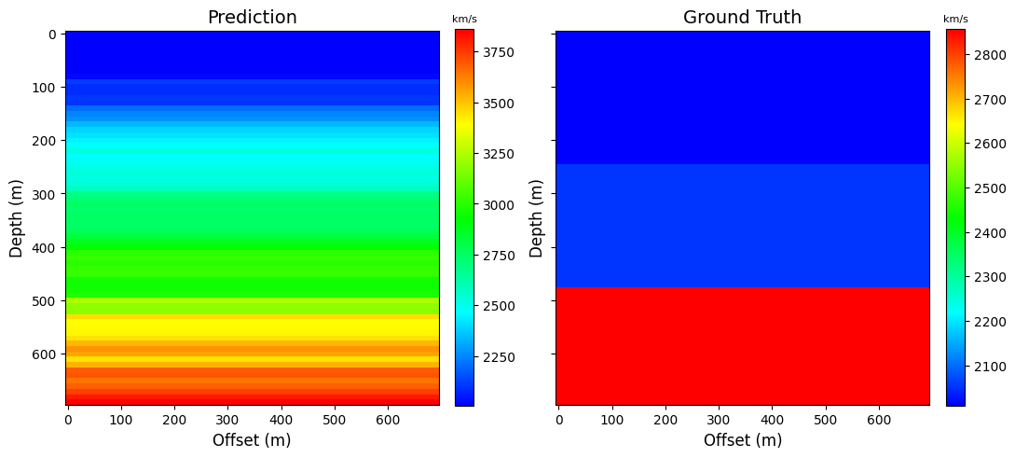
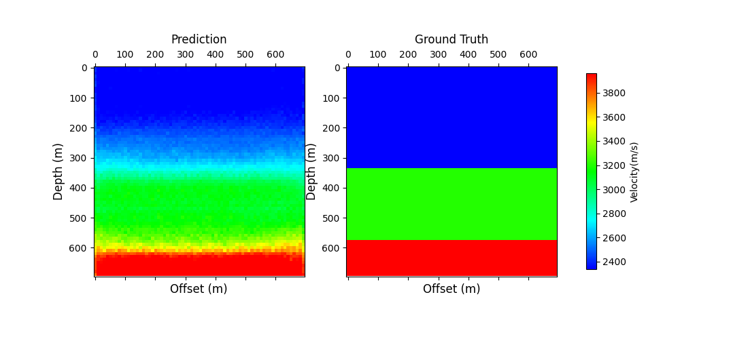
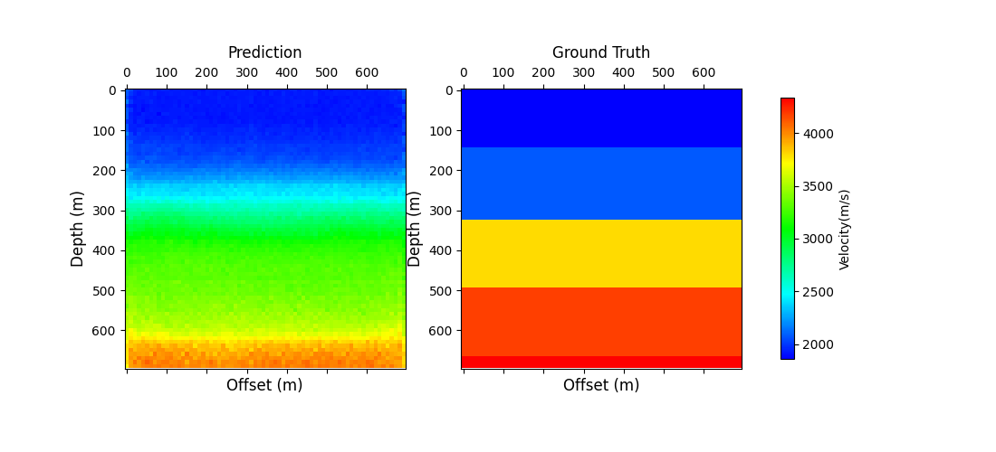
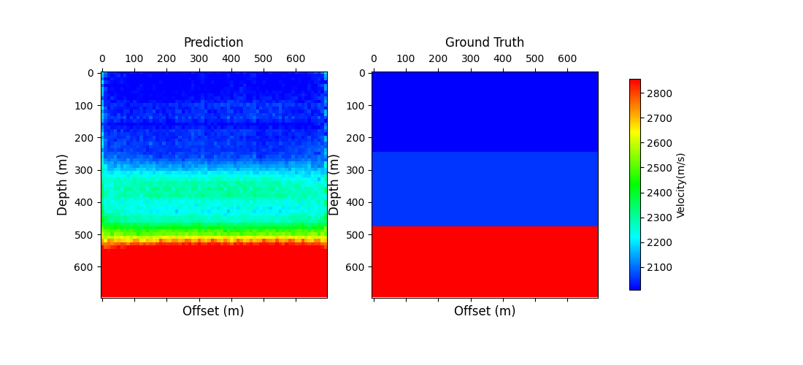
Current Result
K-SVD
MSE: 226370
InversionNet (CNN)
MSE: 44660

Slide 15
References
Deng, C., Feng, S., Wang, H., Zhang, X., Jin, P., Feng, Y., Zeng, Q., Chen, Y., & Lin, Y. (2022). OpenFWI: Large-scale multi-structural benchmark datasets for full waveform inversion. Advances in Neural Information Processing Systems, 35.
Jin, P., Zhang, X., Chen, Y., Huang, S., Liu, Z., & Lin, Y. (2022). Unsupervised learning of full-waveform inversion: Connecting CNN and partial differential equation in a loop. In Proceedings of the Tenth International Conference on Learning Representations (ICLR).
Los Alamos National Laboratory. (2021). OpenFWI [Computer software]. GitHub. https://github.com/lanl/OpenFWI​
Virieux, J., Operto, S. (2009). An overview of full-waveform inversion in exploration geophysics. Geophysics, 74(6), WCC1–WCC26.
Wu, Y., Lin, Y. (2019). InversionNet: An efficient and accurate data-driven full waveform inversion. IEEE Transactions on Computational Imaging, 6, 419–433.
Zhang, Z., Lin, Y. (2020). Data-driven seismic waveform inversion: A study on the robustness and generalization. IEEE Transactions on Geoscience and Remote Sensing, 58(10), 6900–6913.

Slide 16
Thank You！

